Slide 1
The Forward Pass in Neural Network

Slide 2
What is a forward pass?
Input data is passed forward or propagated through a network
Computations performed at each layer
Outputs of each layer passed to each
subsequent layer
Output of final layer: "prediction"
Used for both training and prediction
Some possible outputs:
Binary classification
Single probability between 0 and 1
Multiclass classification
Distribution of probabilities summing to 1
Regression values
Continuous numerical predictions

Slide 3
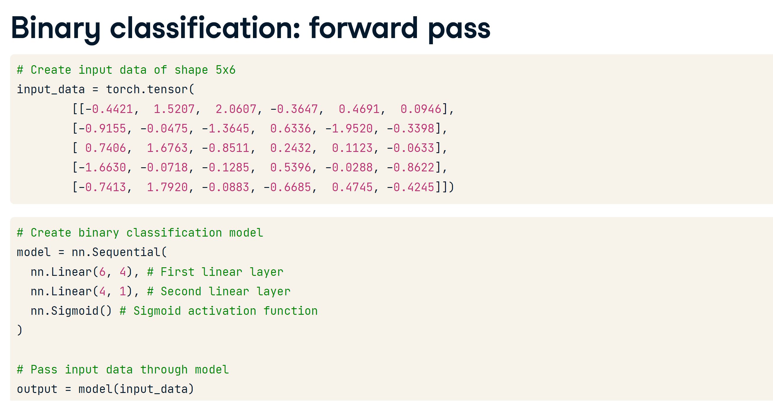
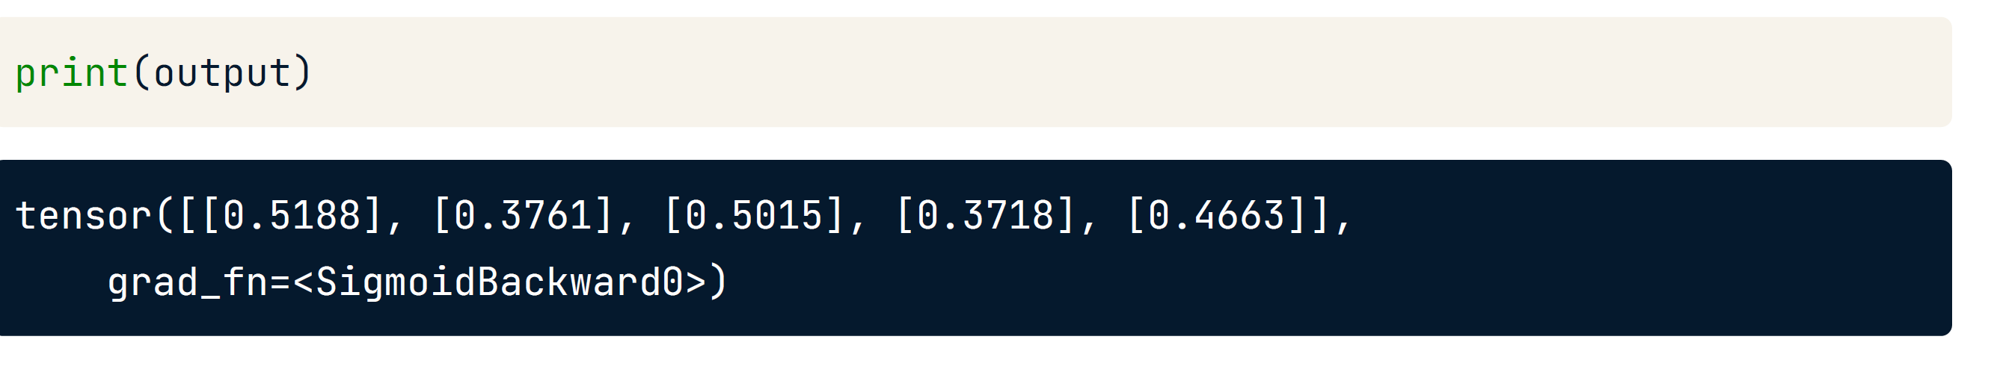
Five probabilities between zero and one, one value for each sample (row) in data
Classification:
Class = 1 for first and third values: 0.5188 , 0.5015 :::::::: Class = 0 for second, fourth and fifth values: 0.3761 , 0.3718 , 0.4633

Slide 4
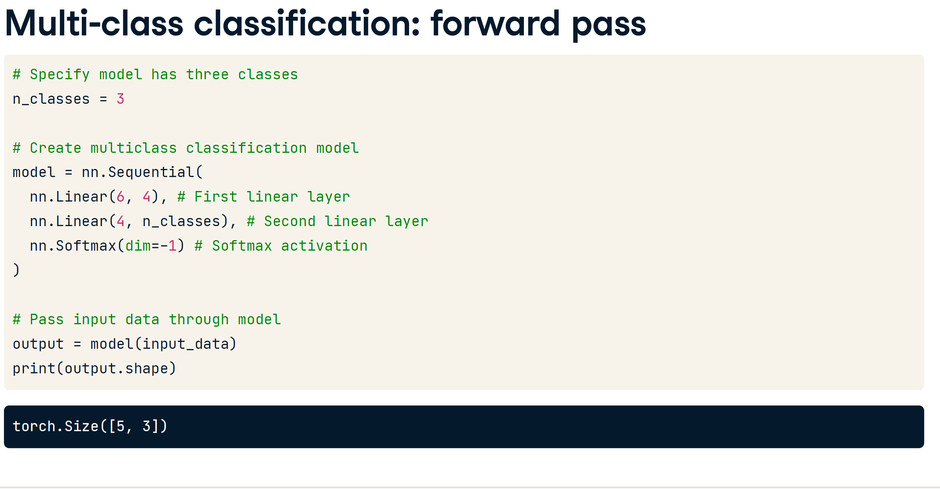

Slide 5
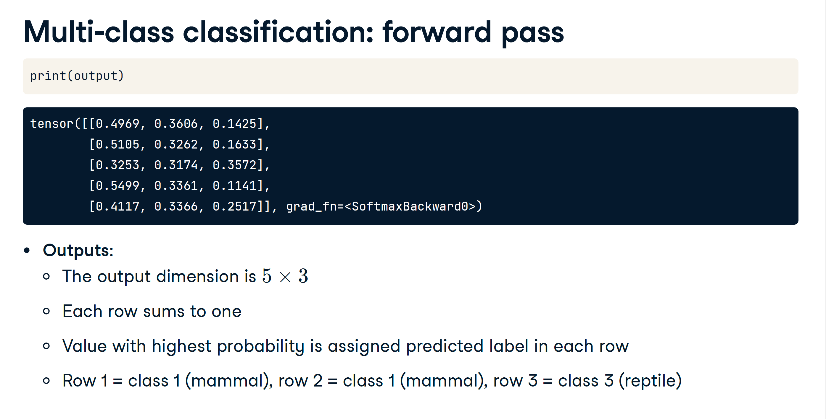

Slide 6
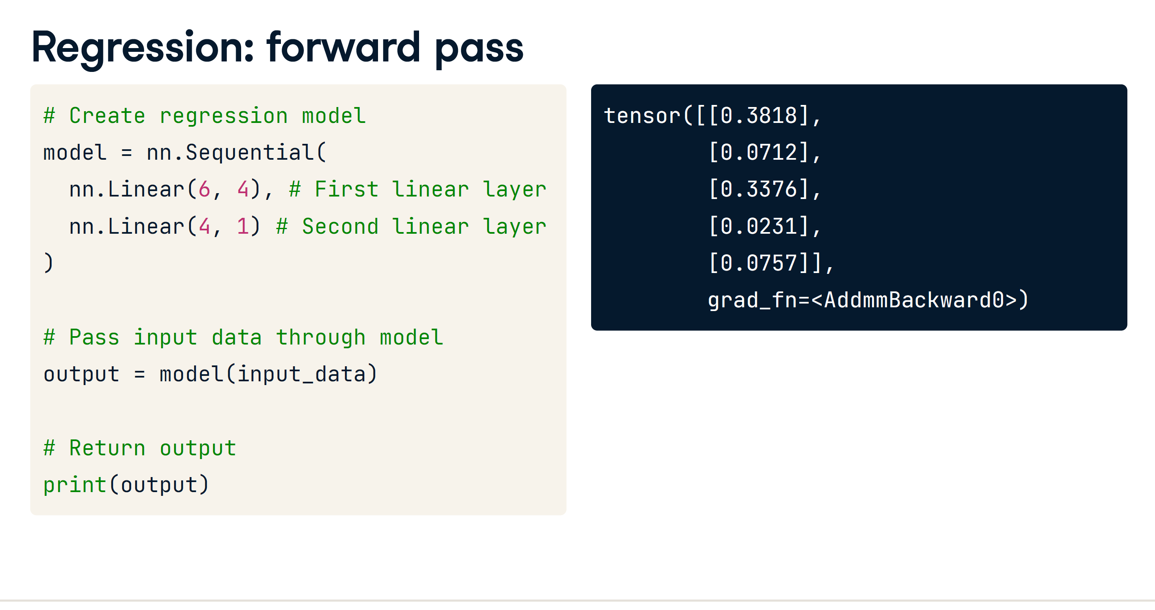

Slide 7
Is there also a backward pass?
Backward pass, or backpropagation is used to update weights and biases during training
In the "training loop", we:
1. Propagate data forward
2. Compare outputs to true values (ground-truth)(Loss Function)
3. Backpropagate to update model weights and biases
4. Repeat until weights and biases are tuned to produce useful outputs

Slide 8


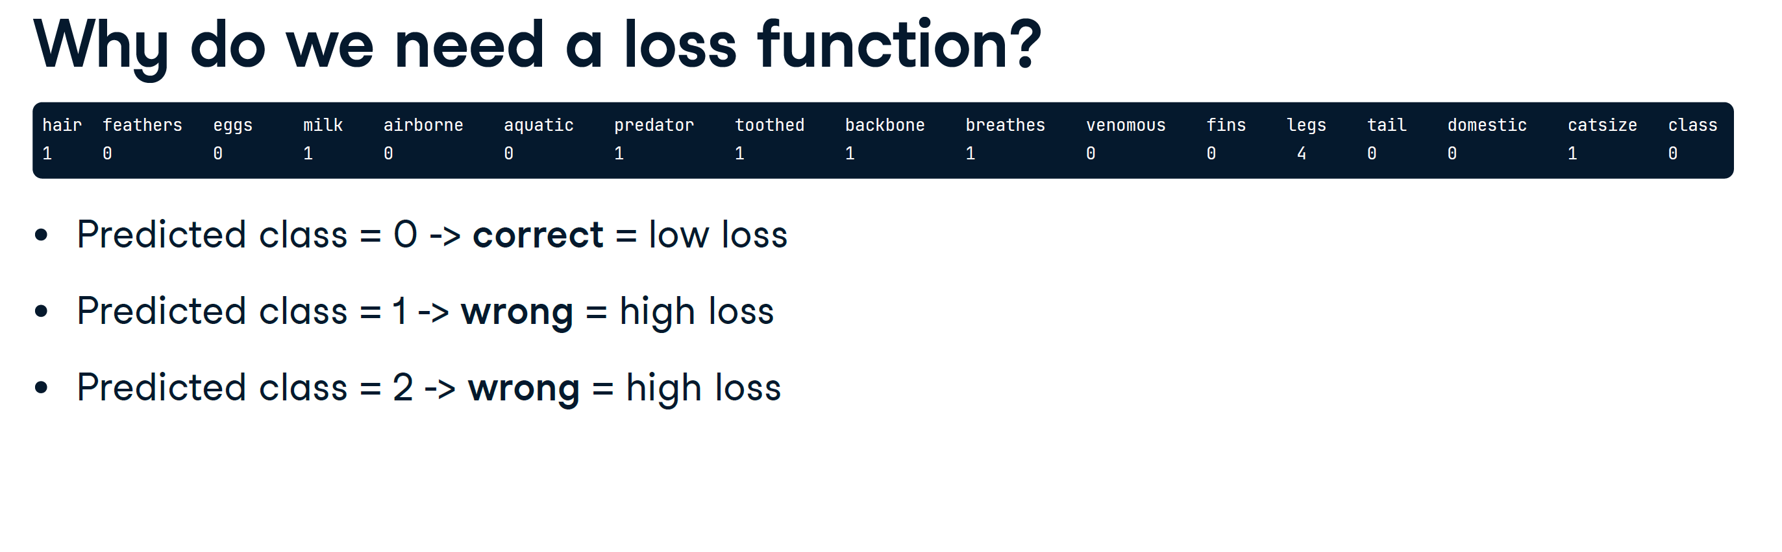
Using loss functions to assess model predictions
Why do we need a loss function?
Loss function:
Gives feedback to model during training
Takes in model prediction and ground truth
Outputs a float

Slide 9
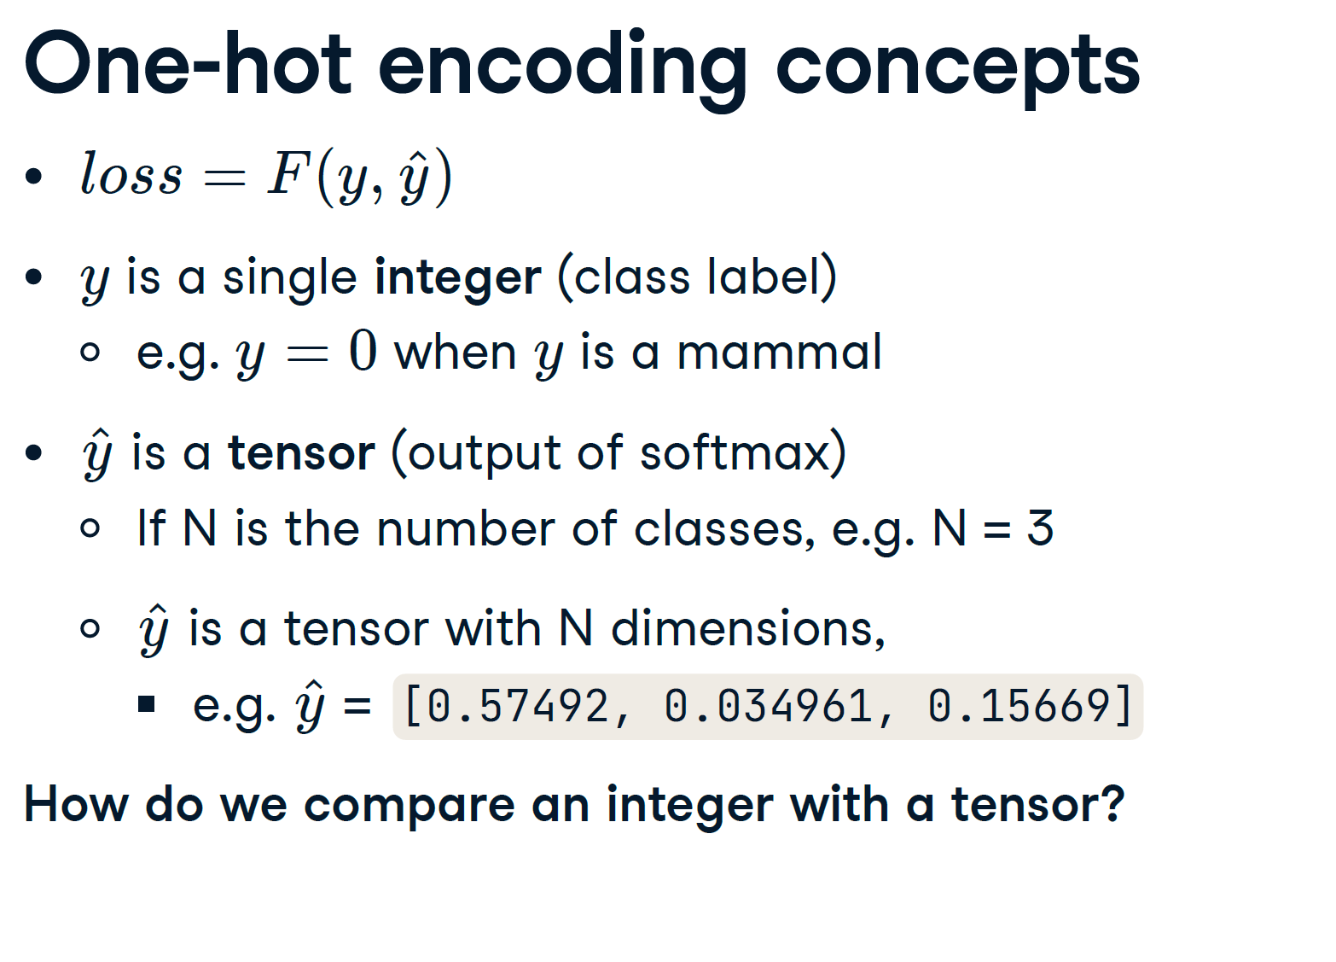

Slide 10
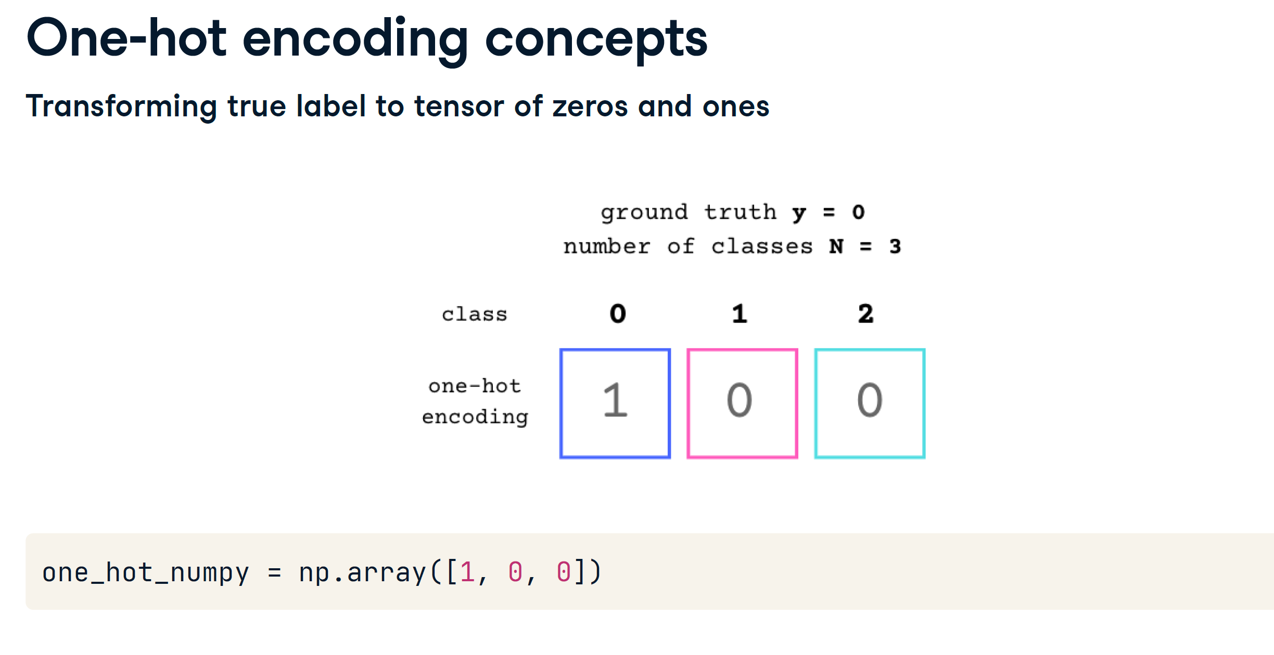

Slide 11
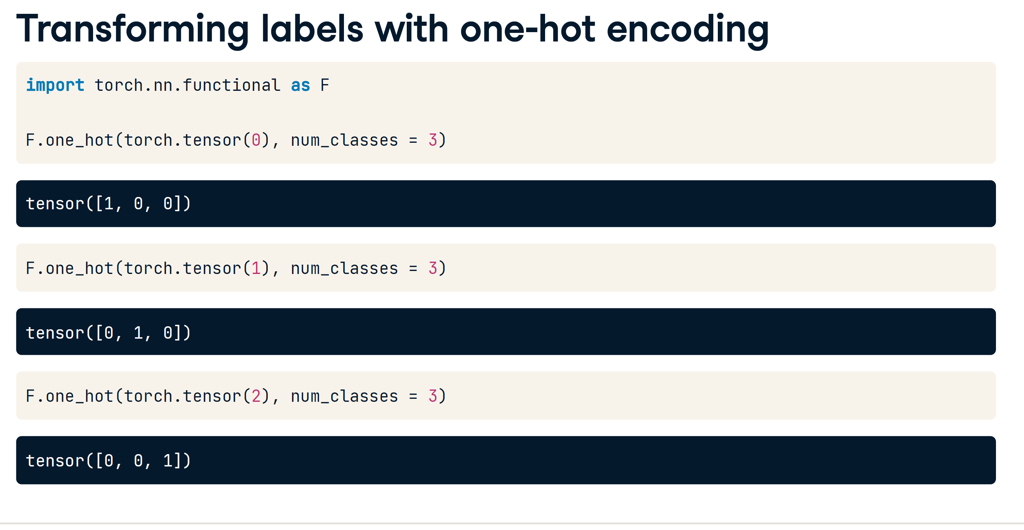

Slide 12
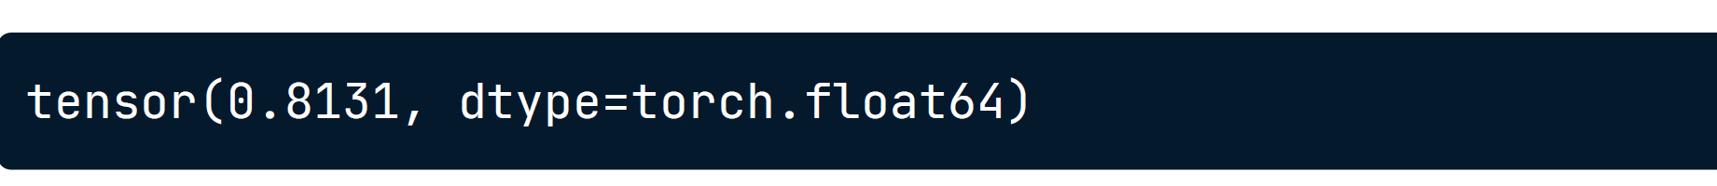
Cross entropy loss in PyTorch
from torch.nn import CrossEntropyLoss
scores = tensor([[-0.1211, 0.1059]])
one_hot_target = tensor([[1, 0]])
criterion = CrossEntropyLoss()
criterion(scores.double(), one_hot_target.double())

Slide 13
Bringing it all together
Loss function takes
scores
model predictions before the final softmax function
one_hot_target
one hot encoded ground truth label
and outputs loss
a single float.
Our training goal is to minimize loss.
Minimizing the loss
We need to minimize loss
High loss: model prediction is wrong
Low loss: model prediction is correct

Slide 14
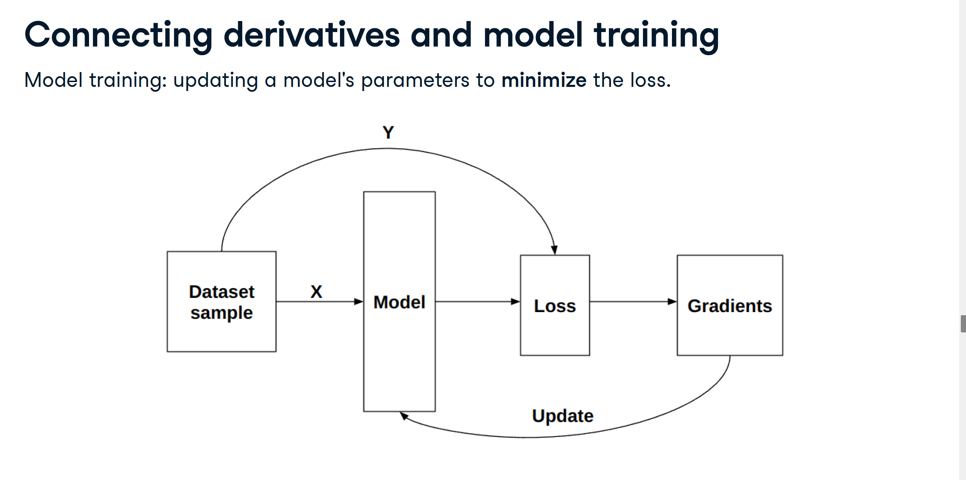

Slide 15
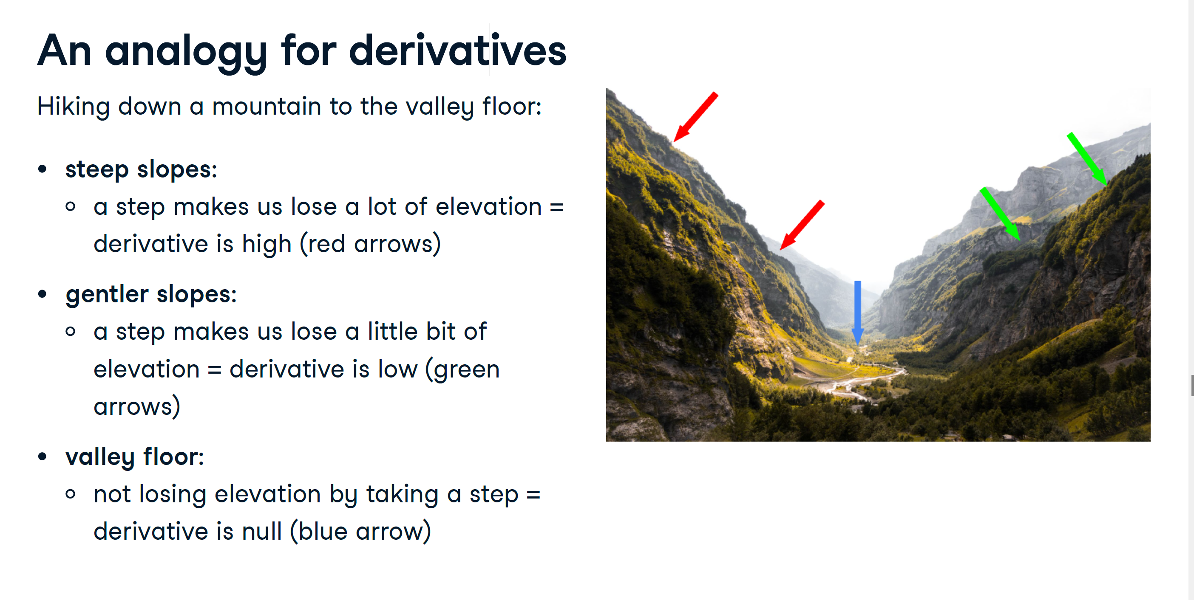

Slide 16
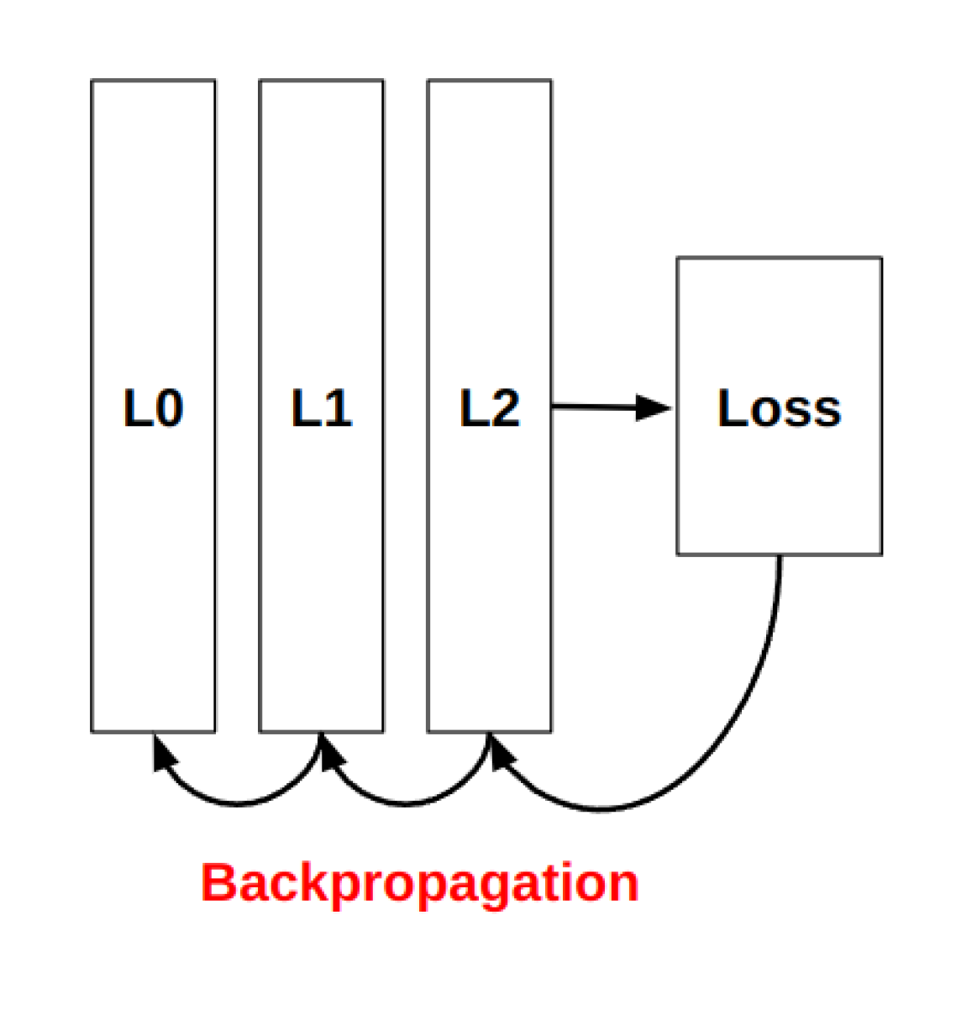
Backpropagation concepts
Consider a network made of three layers,
L0, L1 and L2
we calculate local gradients for L0, L1
and L2 using backpropagation
we calculate loss gradients with respect
to L2, then use L2 gradients to calculate
L1 gradients, and so on

Slide 17
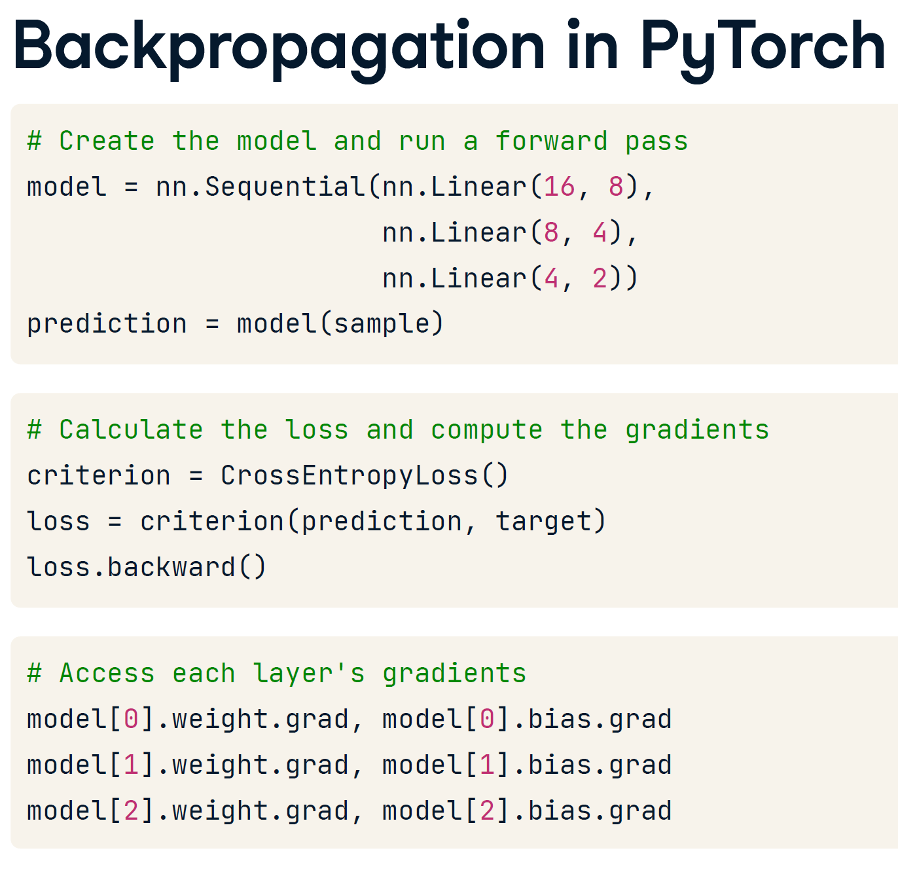

Slide 18
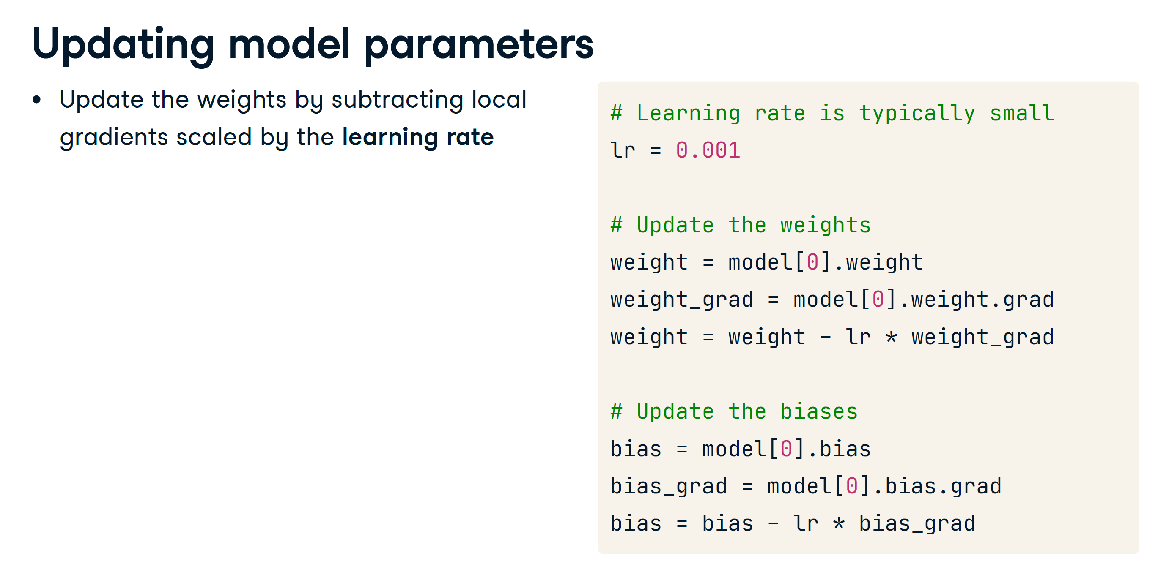

Slide 19
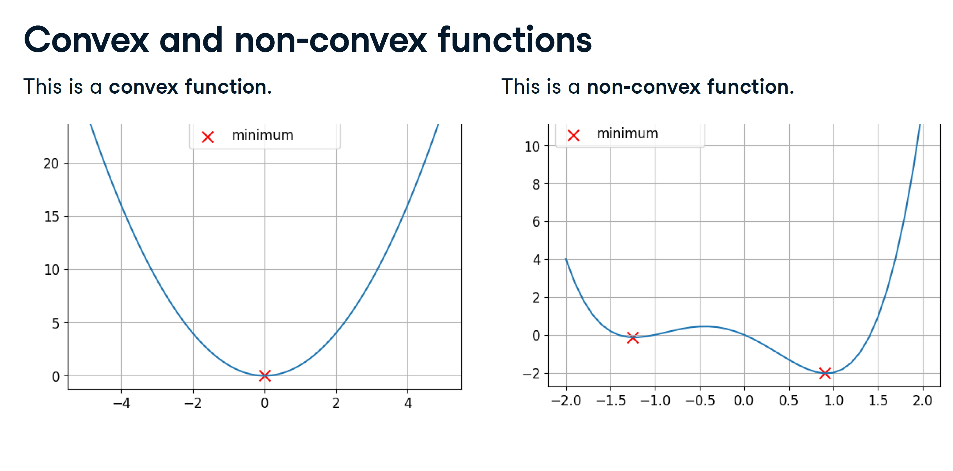

Slide 20
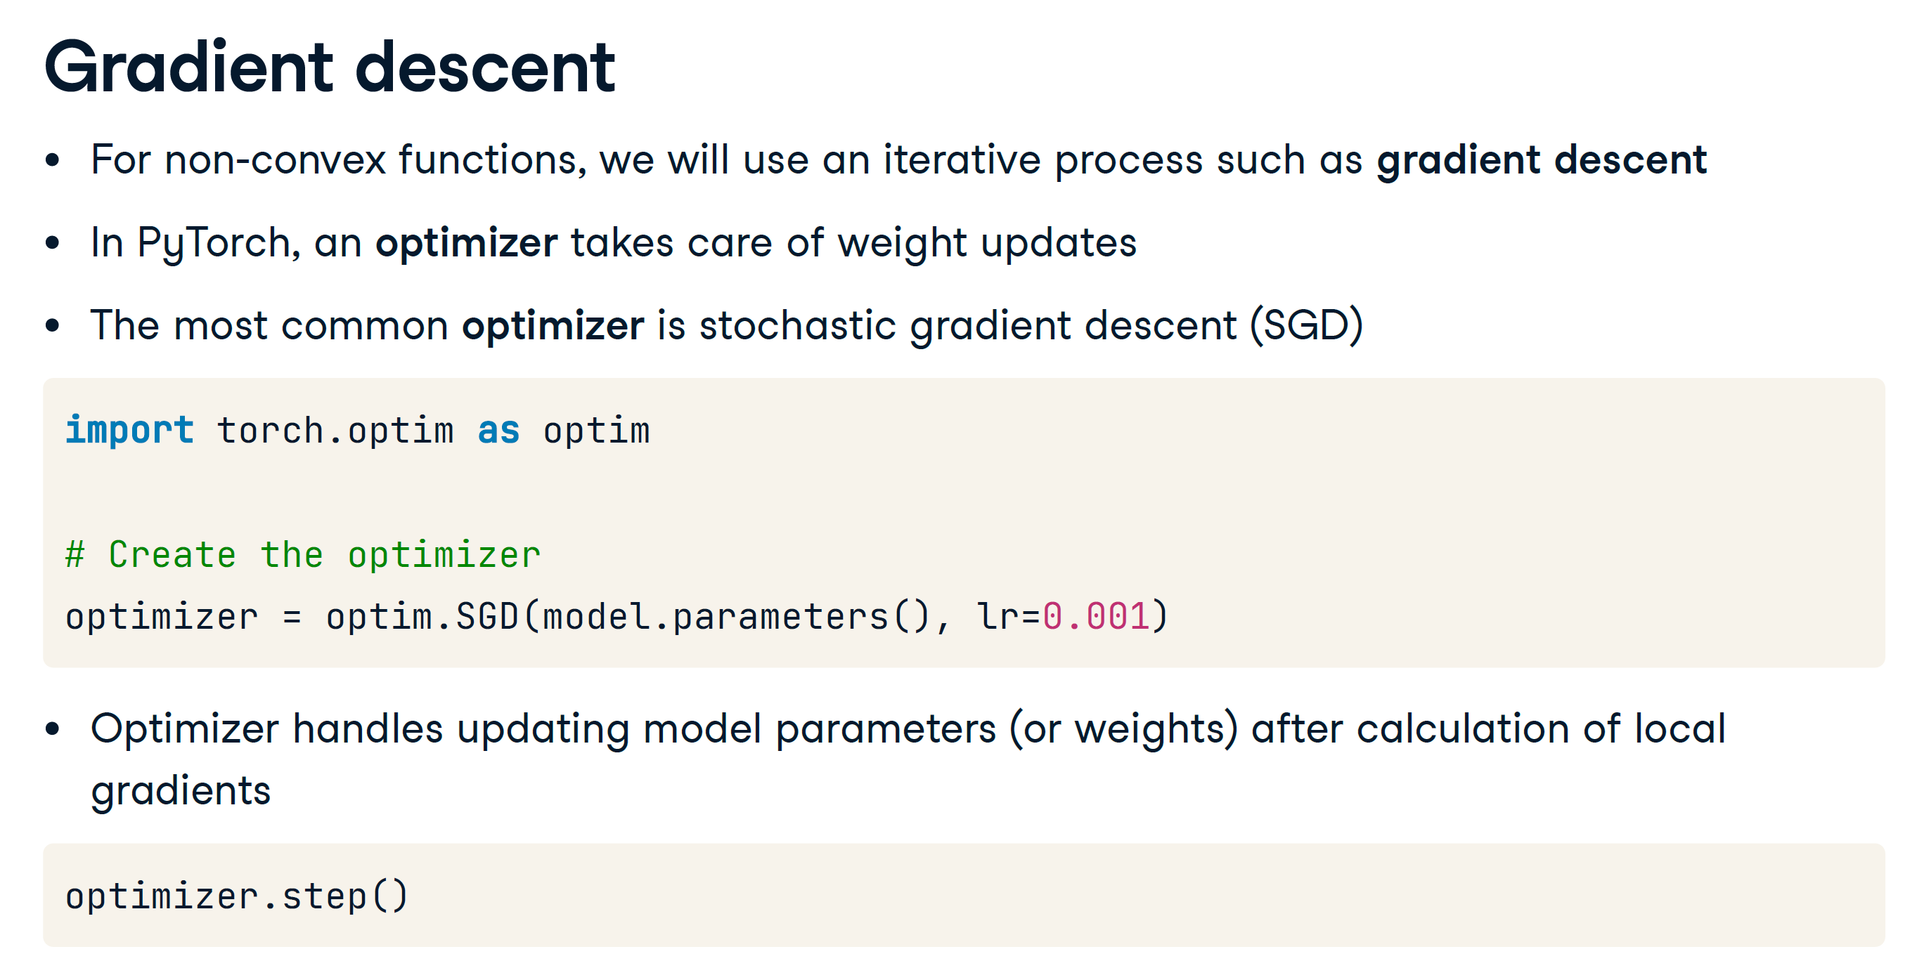

Slide 21
Training a neural network
1. Create a model
2. Choose a loss function
3. Create a dataset
4. Define an optimizer
5. Run a training loop, where for each sample of the dataset, we repeat:
Calculating loss (forward pass)
Calculating local gradients
Updating model parameters

Slide 22
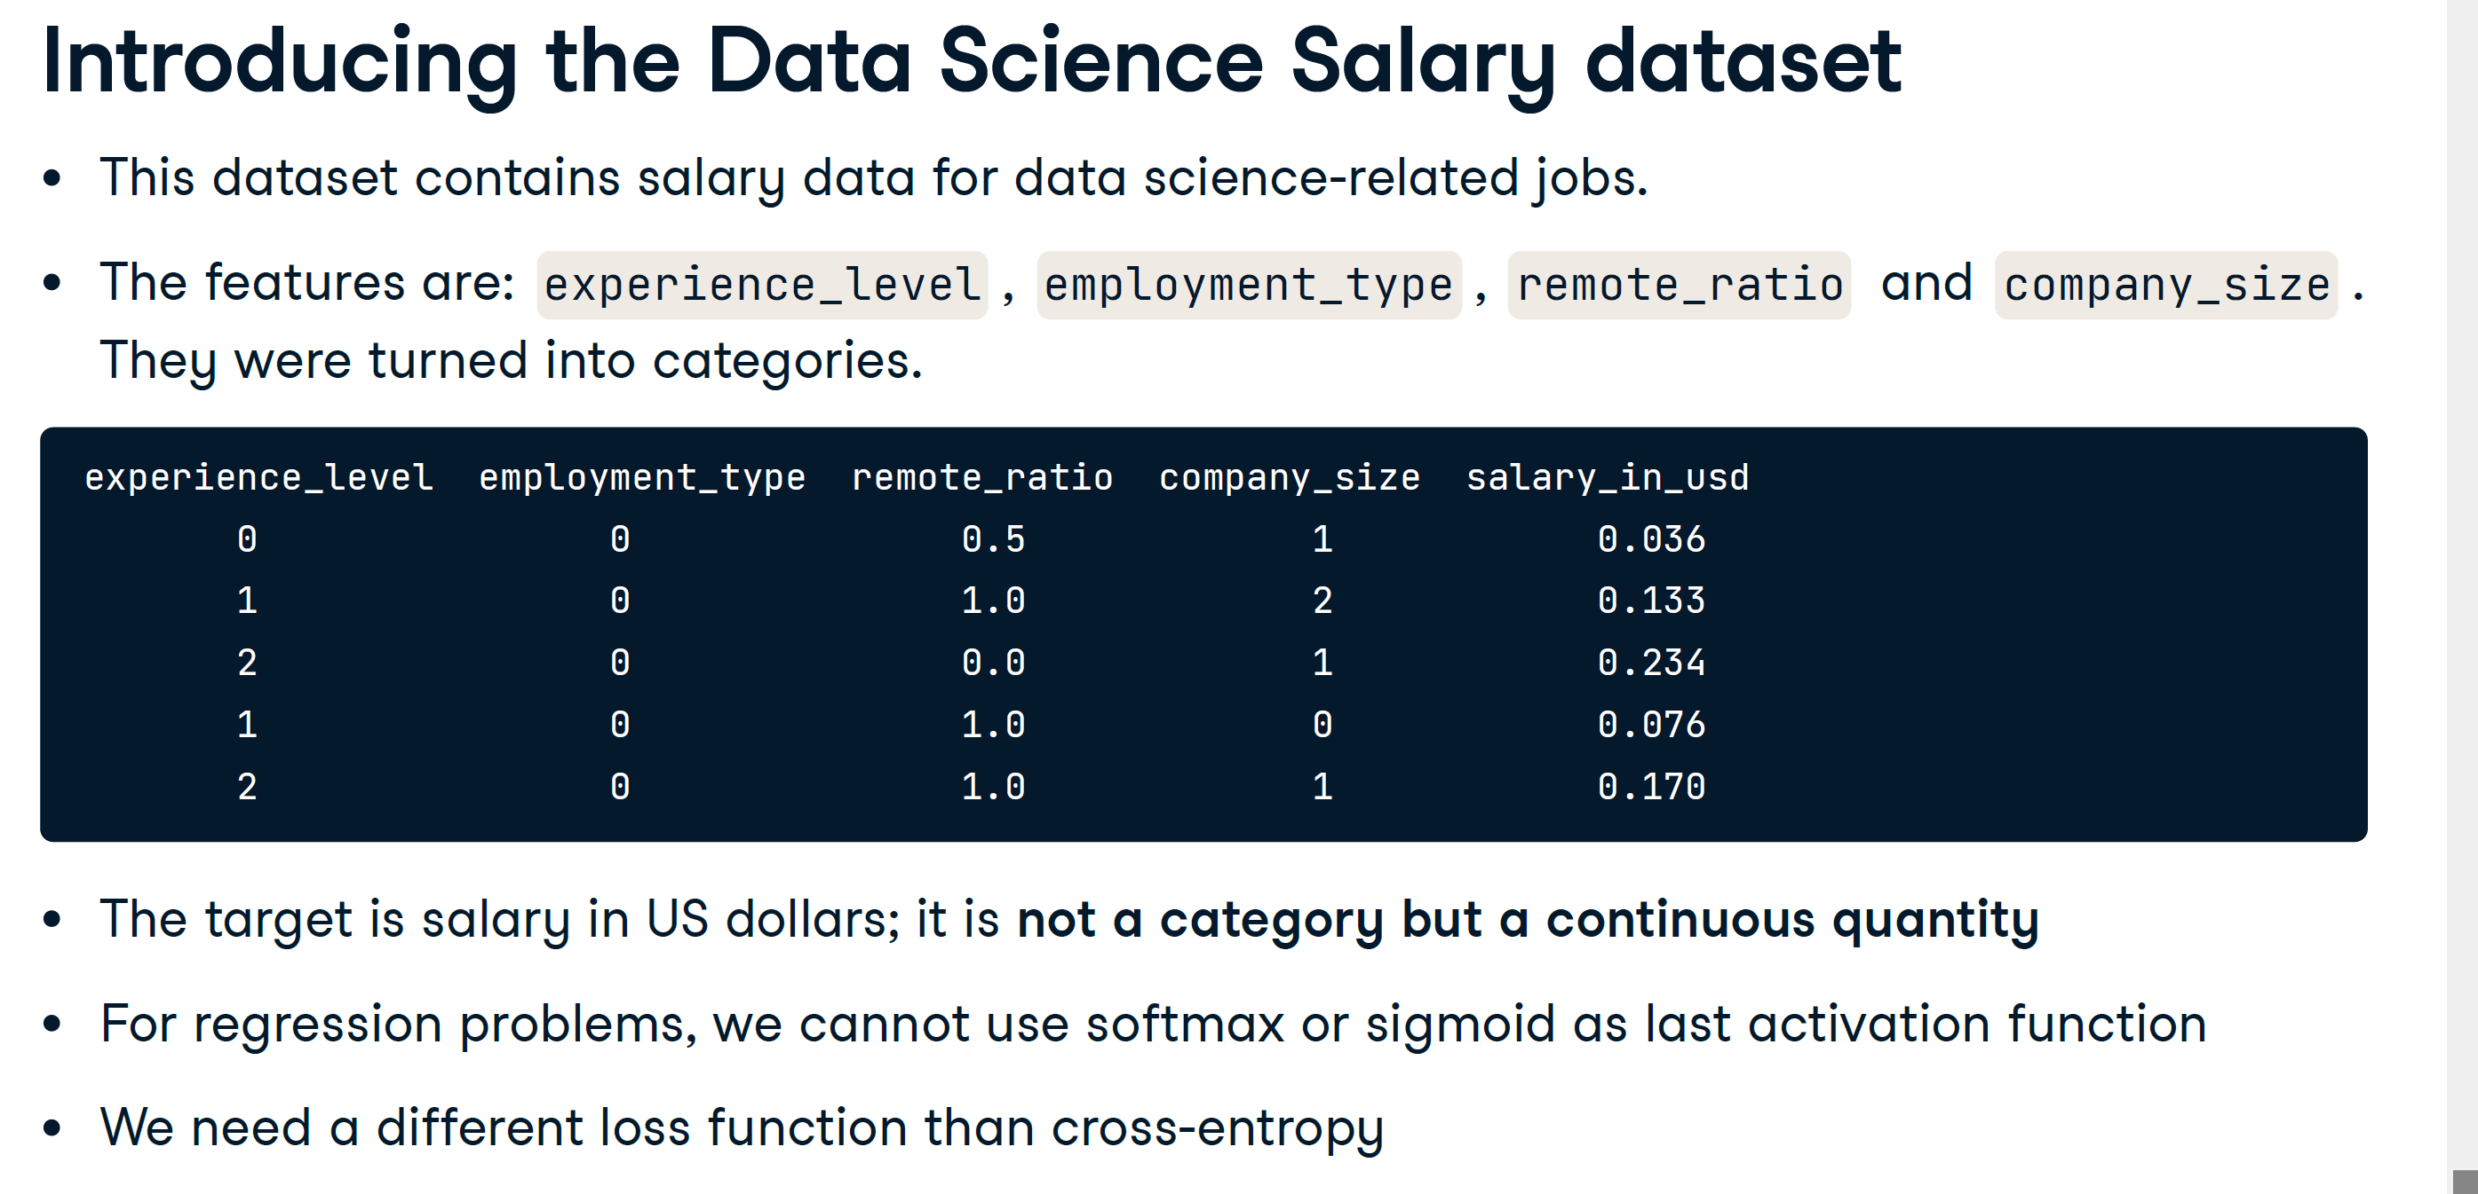

Slide 23
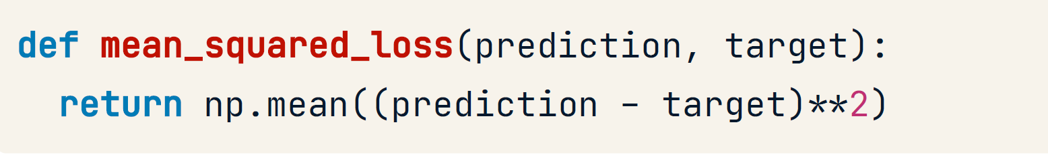
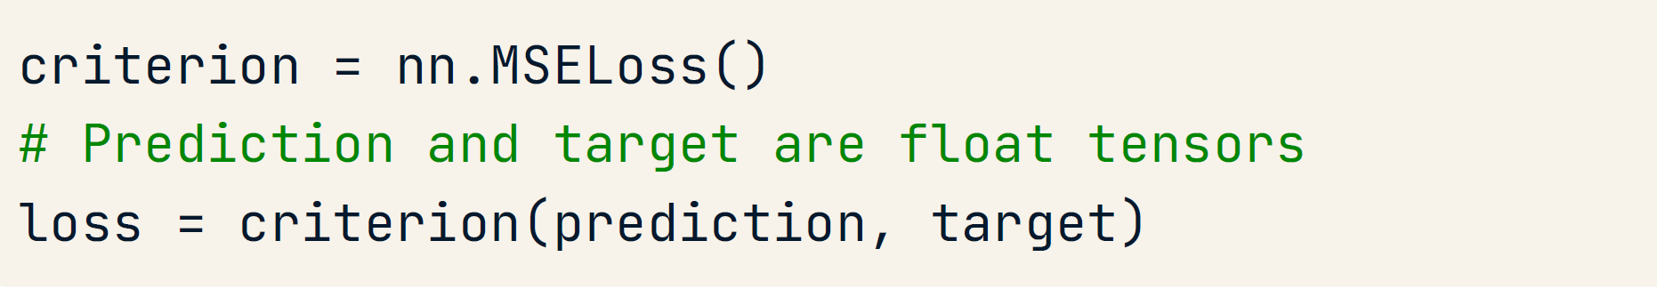
Introducing the Mean Squared Error Loss
The mean squared error loss (MSE loss) is the squared difference between the prediction and the ground truth.
In PyTorch
This loss is used for regression problems (e.g., when trying to fit a linear regression model).

Slide 24
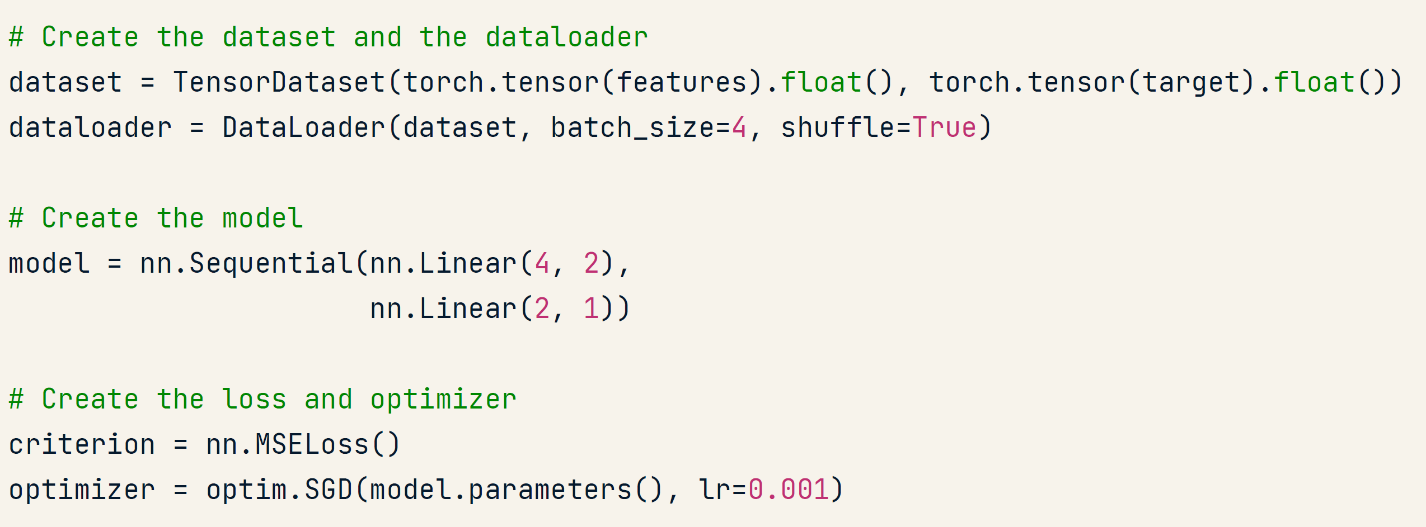

Slide 25
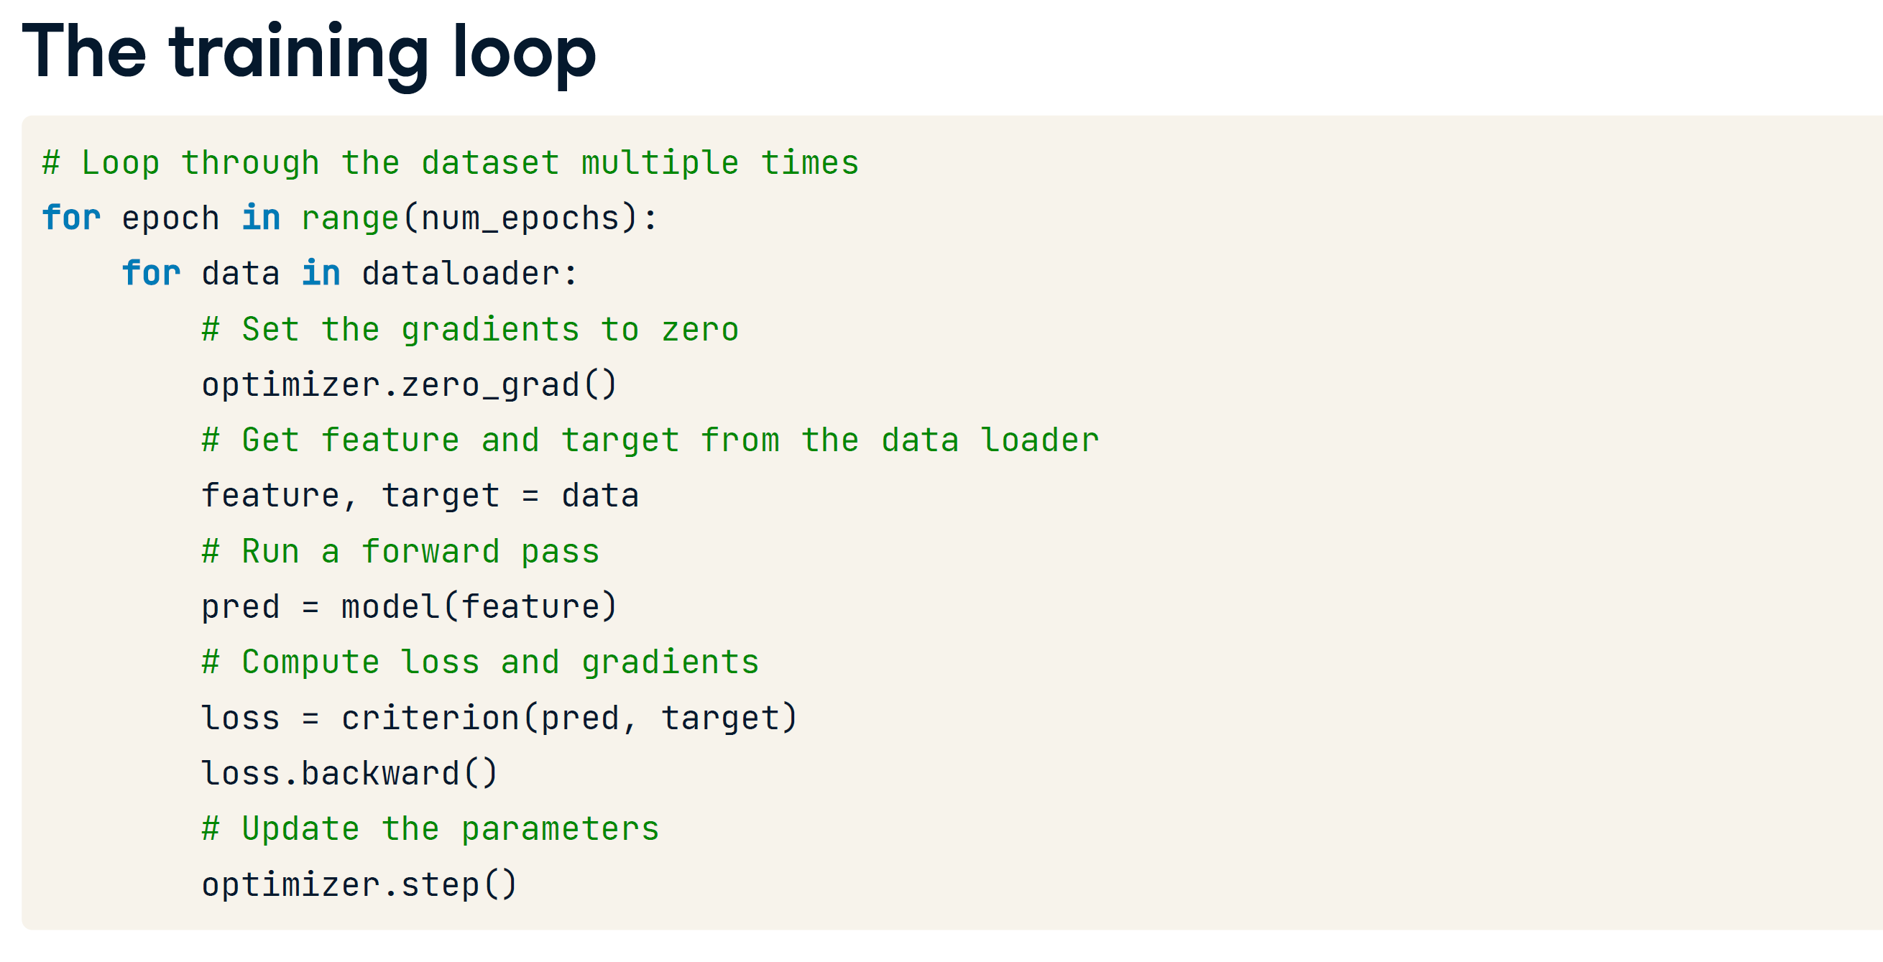

Slide 26
Assignment Instructions
Use the provided UCI datasets or https://archive.ics.uci.edu/datasets
Select one dataset for each of the following types of tasks:
Regression
Binary Classification
Multiclass Classification
Analyze and discuss the metadata of your chosen dataset(s).
List all necessary preprocessing techniques required to prepare the data for embedding into a neural network.
Identify which preprocessing techniques will be applied to your dataset and explain your reasoning.
Perform Exploratory Data Analysis (EDA) on the selected dataset(s) and submit the results as part of your lab assignment. (Lab Assignment)

Slide 27
Additional Notes
Each hidden neuron in a neural network needs different weights for the same input feature to learn distinct patterns and avoid redundancy.
By assigning different weights, neurons can specialize in capturing various aspects of the input data, enabling the network to model complex, non-linear relationships.
This diversity increases the model’s flexibility and capacity to learn rich representations, improving its overall performance and generalization.
Without different weights, the neurons would produce similar outputs, reducing the network's ability to learn effectively.

